Slide 1
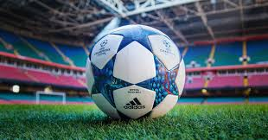
play
soccer

Slide 2
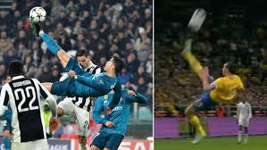
How is this technique recognized?
Chilean
Boleda
eauction

Slide 3
very good
Another question?

Slide 4
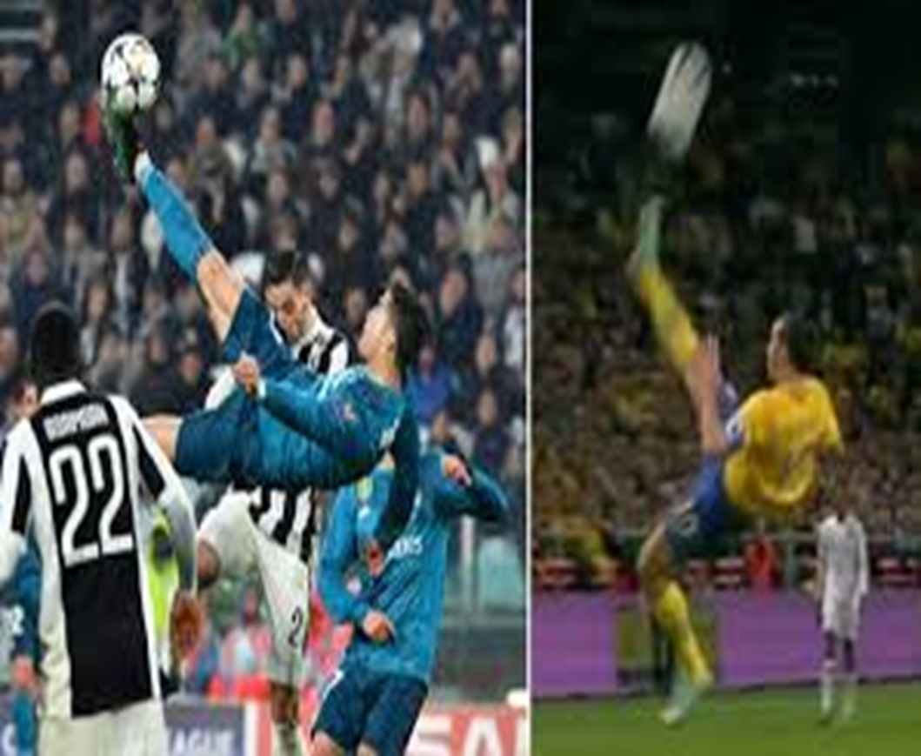
A esto se reconoce como chilena
start over
Next question

Slide 5
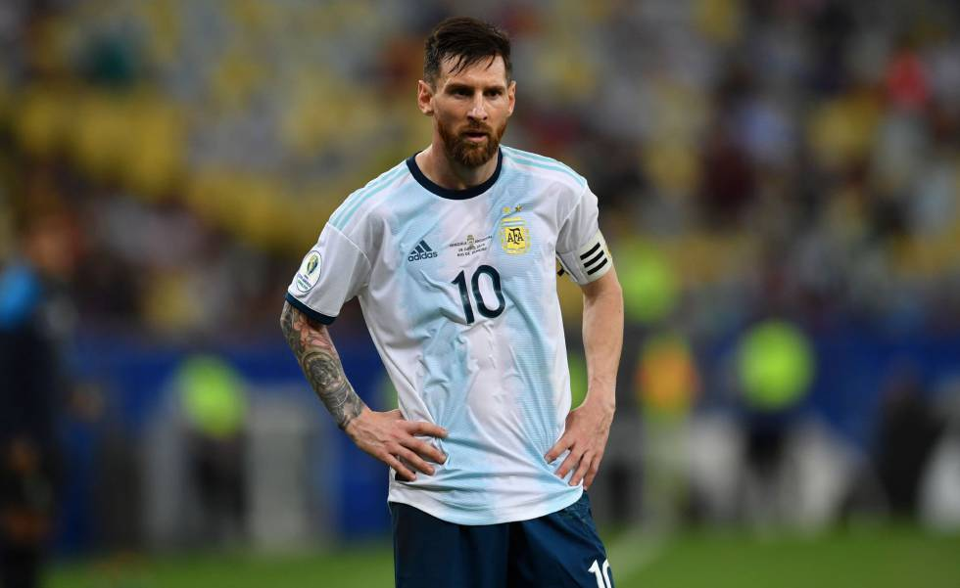
Who is he
Cristiano ronaldo
maradona
pele
Leo messi
ronaldinho
James rodrigez

Slide 6
start over

Slide 7
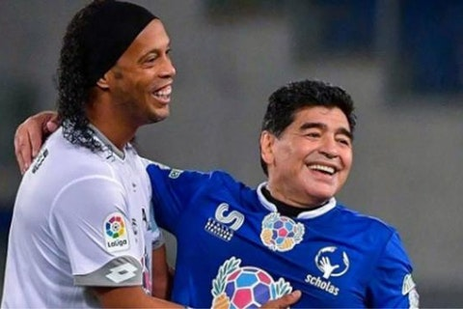
Who are they?
Maradona y ronaldinho
Maradona y neymar
James y ronaldinho
Messi y cuadrado

Slide 8
Another question?

Slide 9
very good
very good
Another question?
very good

Slide 10
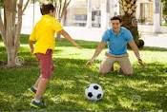
what are you doing
I'm winning with my mother
I am playing soccer with my father
I am playing with my grandfather

Slide 11
Another question?

Slide 12
Another question?

Slide 13
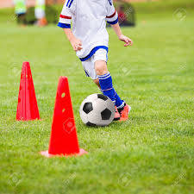
WHAT ARE YOU DOING AS A CHILD
IS PRACTICING BOXING
THE CHILD IS TRAINING
THE CHILD IS ON THE BEACH

Slide 14
Another question?

Slide 15
Another question?

Slide 16
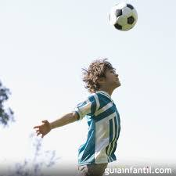
WHAT ARE YOU DOING AS A CHILD
THE GIRL IS HEADING THE BALL
HE'S HEADING THE BALL
THE LORD IS HEADING THE BALL

Slide 17
EXIT

Slide 18
EXIT

Slide 19
Thank you

