Slide 1
ALBERTO CARBAJAL BORRERO
SHARON DAYANNA GOMEZ FLOREZ
GRADO 7-1
MATERIA: INGLES

Slide 2
GAME
START

Slide 3
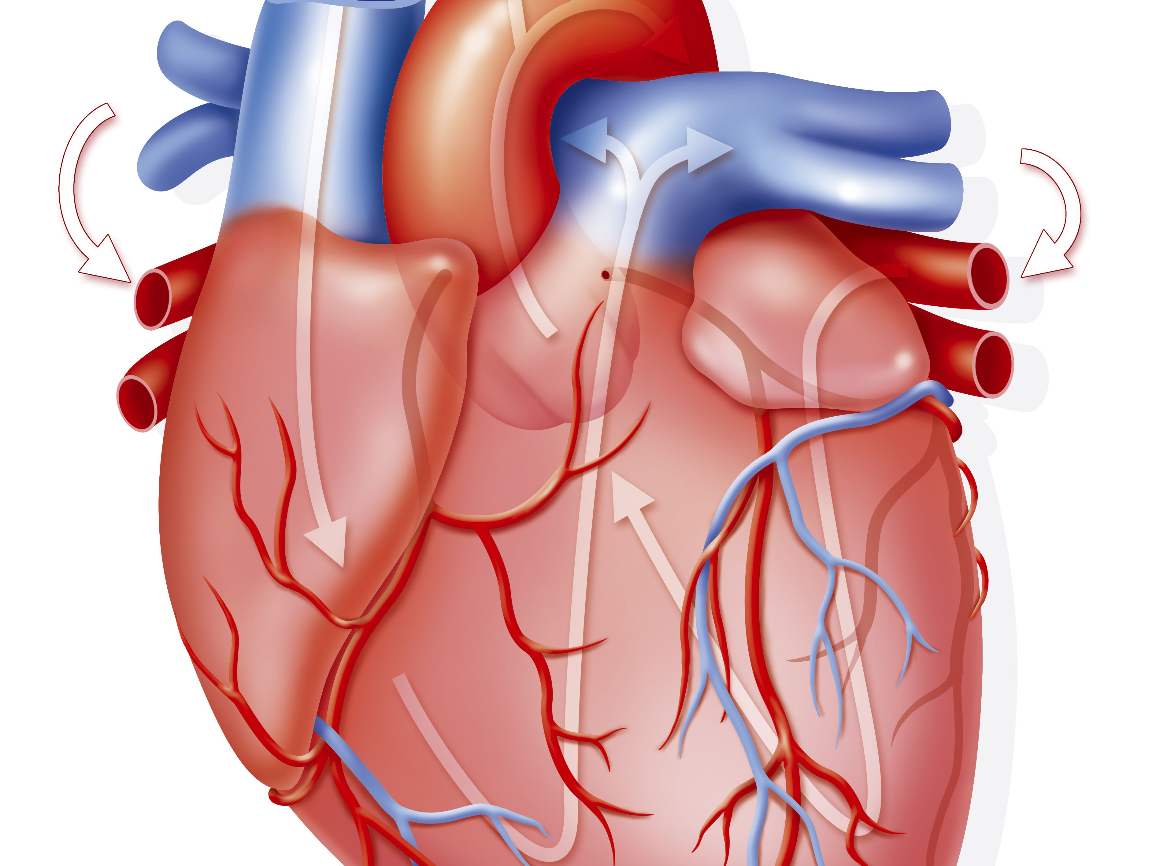
¿what heart weighs more?
A . Sedentary healthy adult
.B . Athlete adult heart

Slide 4
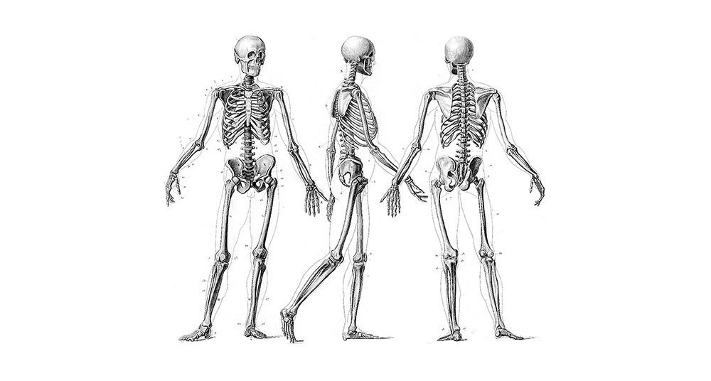
¿How many bones has the human body?
A 105
B 206
C 300

Slide 5
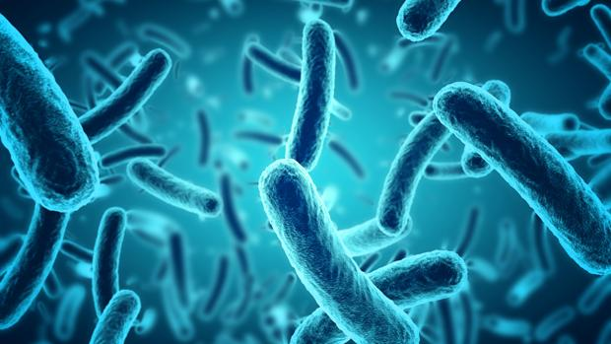
¿which contains more bacteria?
A SALIVA
B BLOOD
C URINE

Slide 6
láser
try again

Slide 7
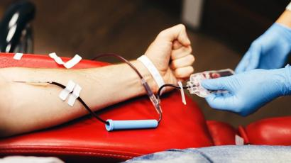
¿per year, how many times can a man donate blood?
A . 2 TIMES
B . 4 TIMES
C . 5 TIMES

Slide 8
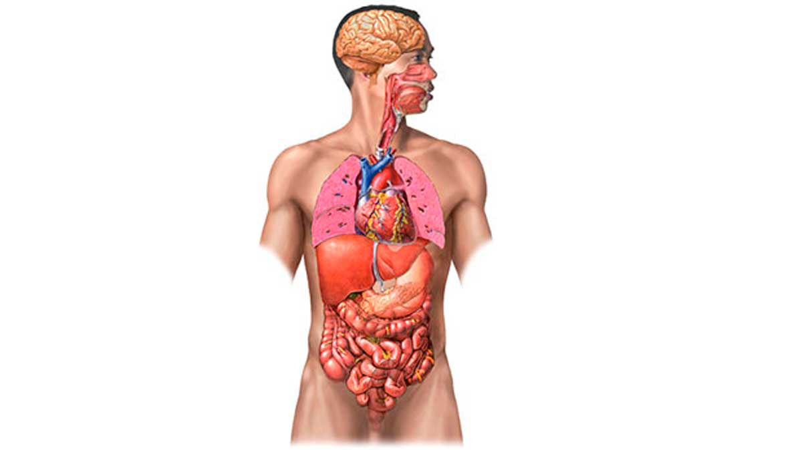
¿which is the largest internal organ?
A . Estomago
B . Skin
C . Liver

Slide 9
the nails are composed of:
A . Calcium
B . Keratin
C . Dermis

Slide 10
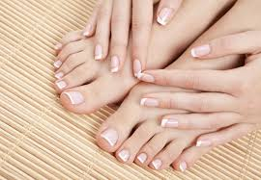
¿which member has more bones?
A . Feet
B . Hands

Slide 11
Right
following

