Slide 1
presented by: Shara yasno
Presented to: Marlin Sanchez
TOPIC: Animals
GO

Slide 2
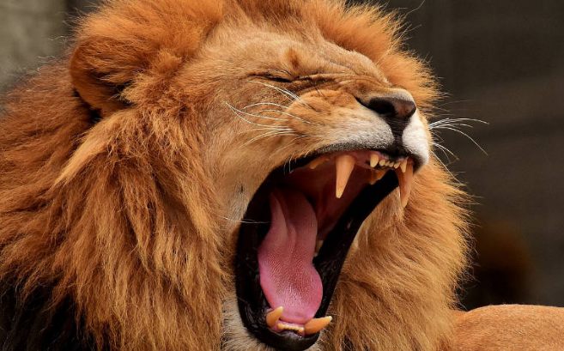
THE LION IS:
Herbivores
Carnivorous
Omnivores

Slide 3
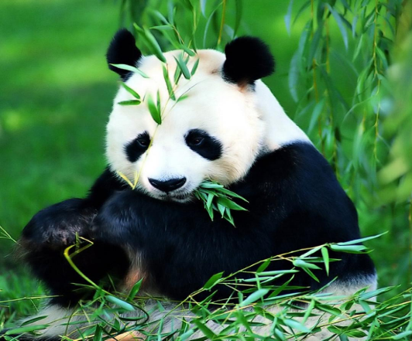
In which continent does the panda bear live
Europa
África
Asia

Slide 4
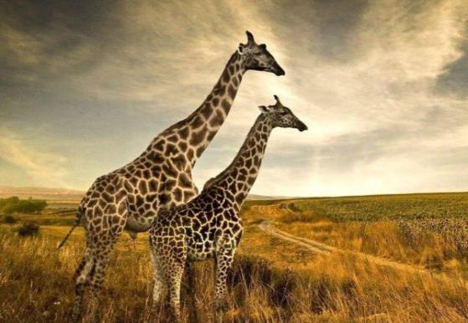
HOW MUCH IS THE GESTATION TIME OF A GIRAFFE
15 MOTHS
10 MOTHS
20 MOTHS

Slide 5
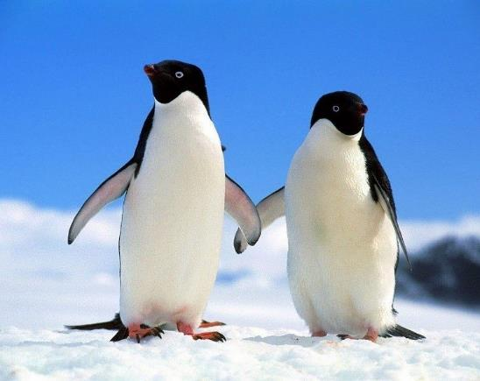
HOW MUCH IS THE AVERAGE LIFE OF A PENGUIN
15 YEARS
30 YEARS
20 YEARS

Slide 6
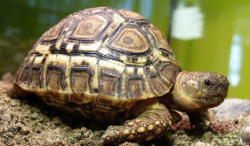
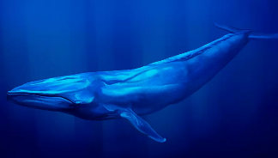
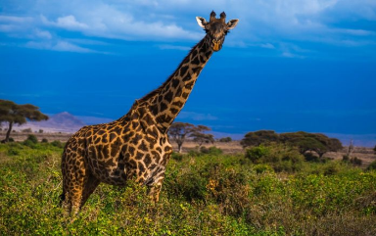
which of these animals is not a mammal
Blue whale
Giraffe
Tortoise

Slide 7
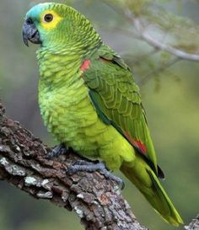
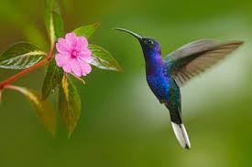
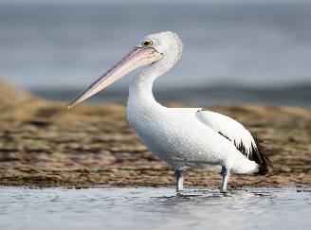
which is the bird that lays the smallest egg
Hummingbird
Parrot
Pelican

Slide 8
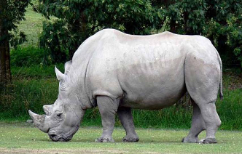
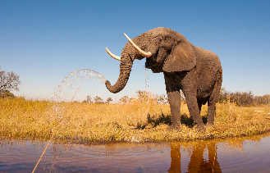
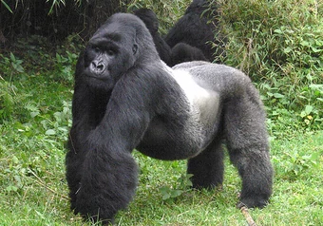
What is a bípedal
Elephat
Rhino
Gorilla

Slide 9
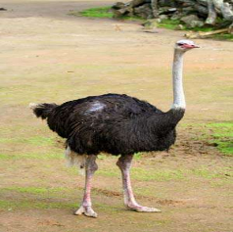
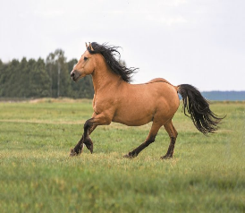
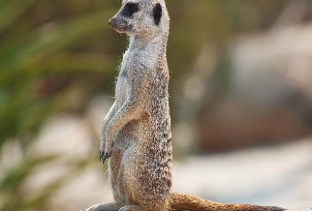
which is a quadruped
Horse
Meerkat
Ostrich

Slide 10
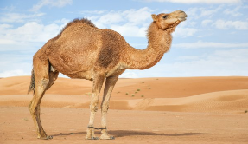
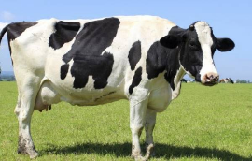
What animal is characterized by having 4 stomachs
Camel
Cow
Horse

Slide 11
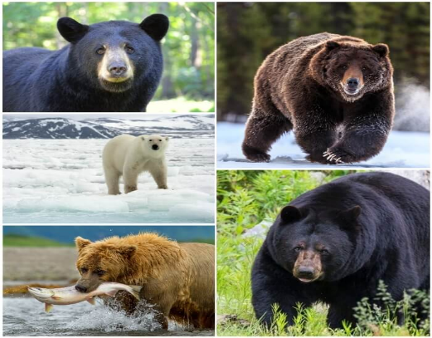
how many species of bears are there
10 species
15 species
8 species

Slide 12
VERY GOOD
2
3
4
5
6
7
8
9
10
11

Slide 13
GAME OVER
2
3
4
5
6
7
8
9
10
11

