Slide 1
My dream house

Slide 2
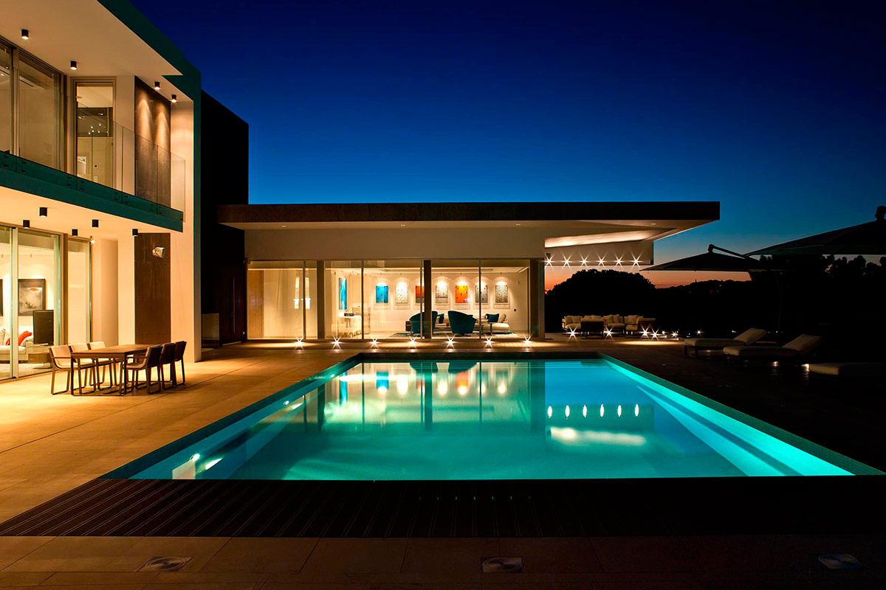
I dream to live in a private house somewhere in the quite suburb of the city.
There are 2 bedrooms, 2 bathrooms, 2 living rooms, a study, a kitchen, a recreation room, a gym, a balcony and a swimming pool.

Slide 3
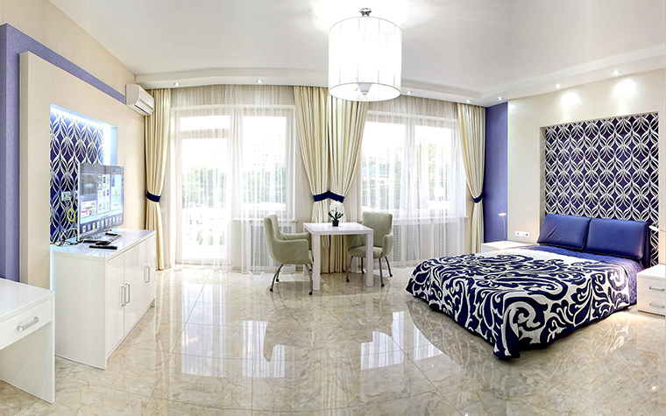
This is my bedroom. It is very big and bright.
There is a big bed near the wall, a table with two chairs near my bed and a TV opposite the bed.
I like minimal but with style.

Slide 4
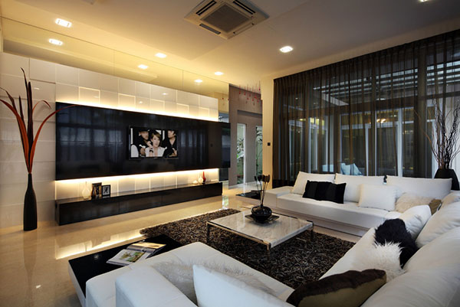
This is my living room
There is a big sofa, There are white, black and green pillows on the sofa. There is a furry brown carpet on the floor. There are brown curtains on the windows. My living room is cozy and stylish

Slide 5
My living room
There is also a TV set in front of the sofa and a lamp near it.

Slide 6
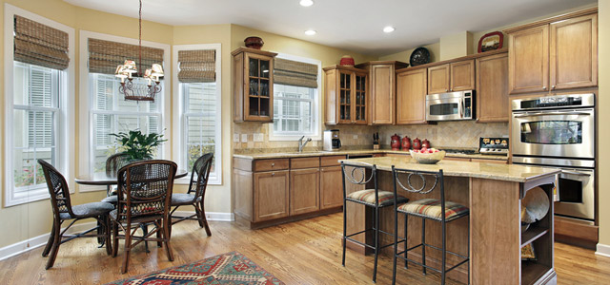
This is my kitchen
There is a modern kitchen set in my kitchen. There are shelves, cupboards, a sink, a microwave oven, an oven, a fridge, a freezer, a table and some chairs in my kitchen.

Slide 7
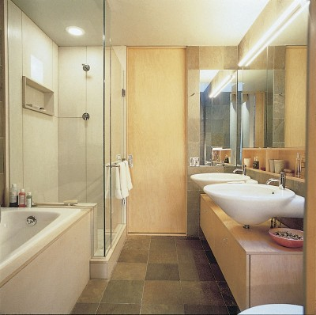
This is my bathroom
There is a toilet pan, a bath, a shower, 2 a sink and a mirror in my bathroom.

Slide 8
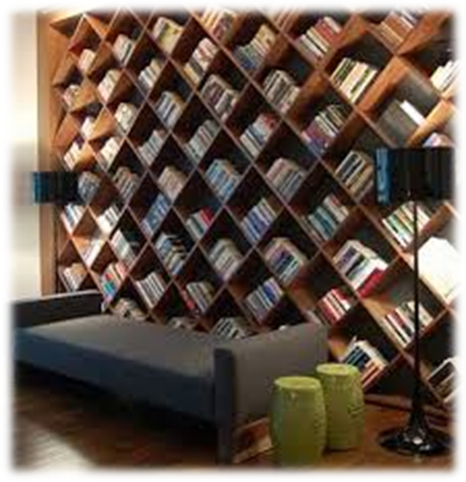
my library
This is my library with such masterpieces as Shakespeare, Margaret Mitchell and L.N Tolstoy.

Slide 9
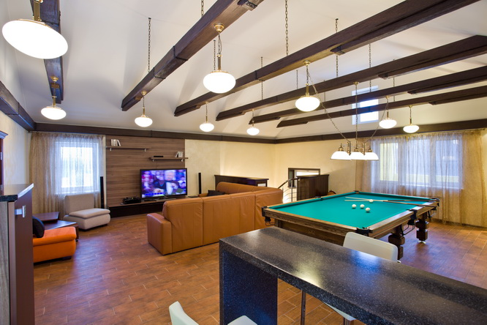
This is the break room. There is a pool table, a large sofa, TV and two armchairs

Slide 10
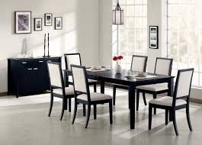
This is my dining room
There is a table in the middle of my dining room. There are six chairs around the table. There are pictures on the wall. There is also a wooden chest of drawers, a vase and candles on it.

Slide 11
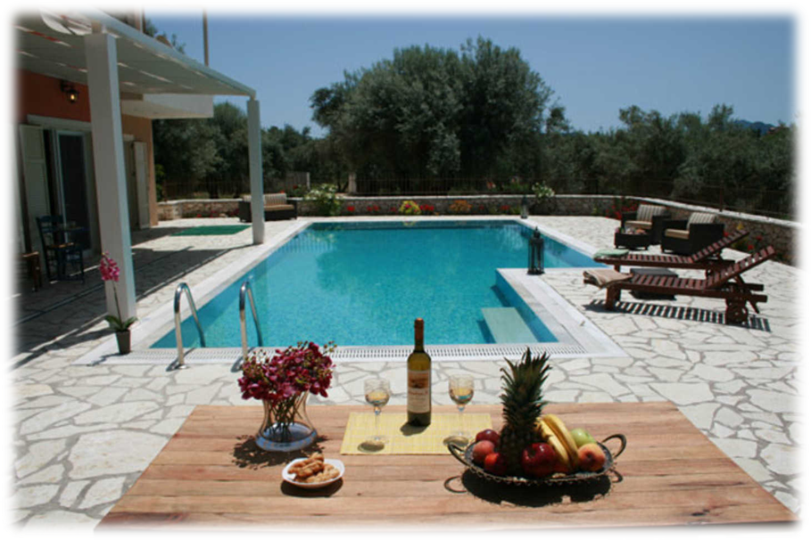
This is my swimming pool. You can swim in it and sunbathe nearby.
opposite the swimming pool has a wooden table.

