Slide 1
I.E. ALBERTOCARVAJAL BORRERO Miguel Ángel Romero Grade:7-1 Topic: Game Teacher: Marlín Sánchez

Slide 3
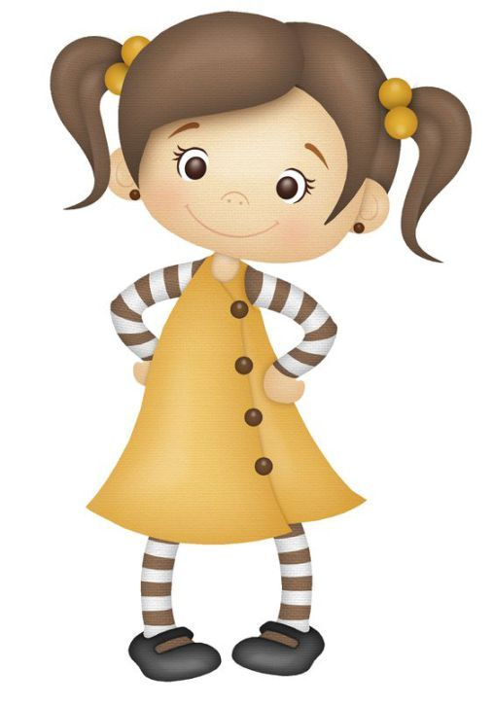
¿WHAT IS THE MOTHER?

Slide 4
¿ HOW MANY BROTHERS DO YOU THINK I HAVE?
2
1
3

Slide 5
¿WHAT A BROTHER DO YOU THINK I AM?
Hermano grande
Hermano pequeño
Hermano mediano

Slide 6
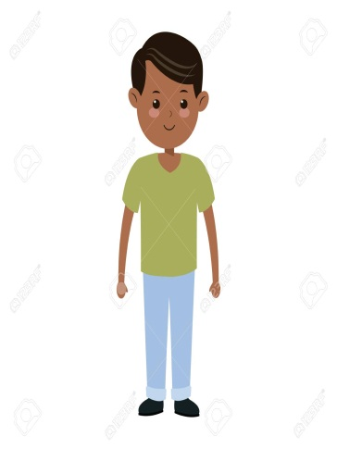
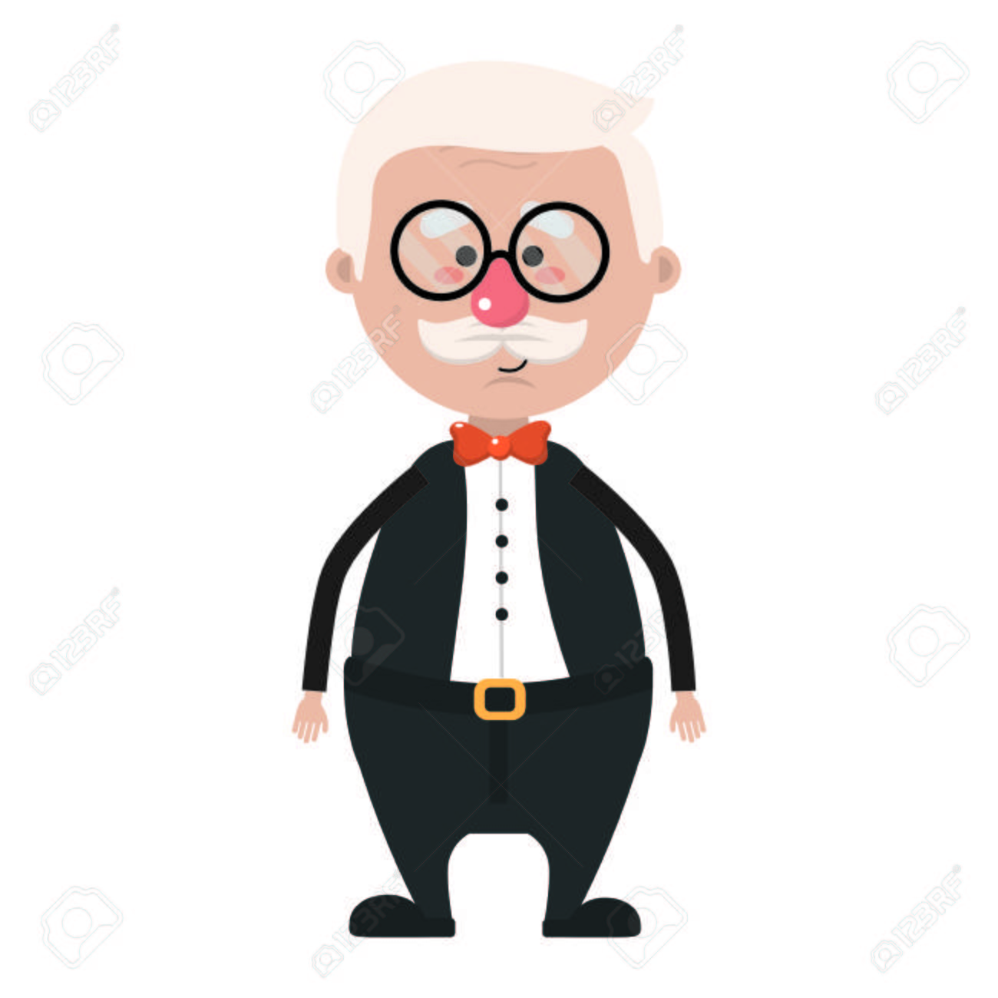
¿wich is the father?

Slide 7
VERY GOOD

Slide 8
VERY GOOD
4

Slide 9
VERY GOOD
2.

Slide 10
GAME OVER
1.

