Slide 1
presented by: Daniel Salazar
To: Teacher and colleagues
subject: English and technology
theme: Animals
what does it consist of: There will be a series of questions that you will answer in the form of a game
WE GO

Slide 2
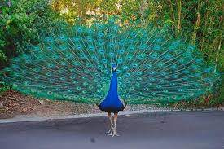
which is the correct one?
peakok
Peacock
Peacok

Slide 3
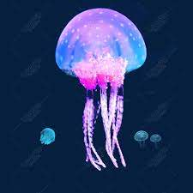
which is the correct one?
jellyfish
Jellifish
gellyfish

Slide 4
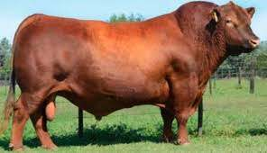
which is the correct one?
bull
bul
Vull

Slide 5
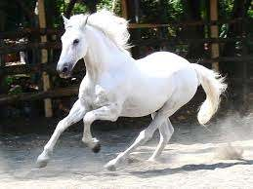
which is the correct one?
Orce
horce
horse

Slide 6
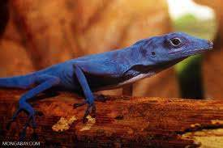
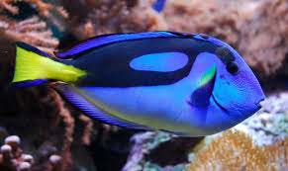
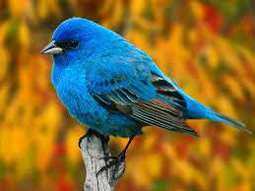
What is the bird?

Slide 7
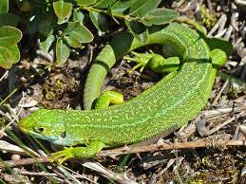
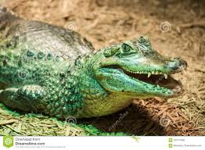
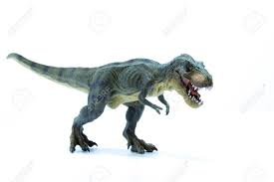
what is an iguana?

Slide 8
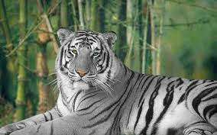
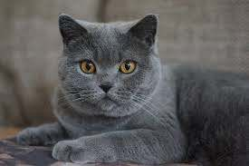
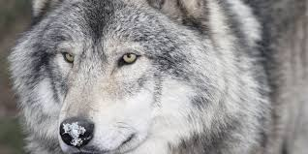
what is a pet?

Slide 9
1
sorry, try again
2
3
4
5
6
7

Slide 10
1
Congratulations
2
3
4
5
6
7

Slide 11
End of the game. Thanks for playing

