Slide 1
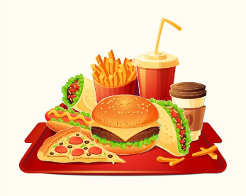
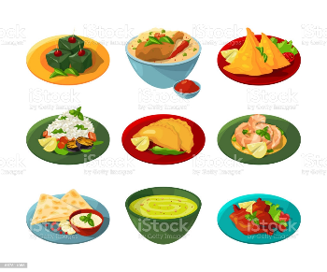
FIND OUT HOW MUCH YOU KNOW ABOUT FOOD

Slide 2
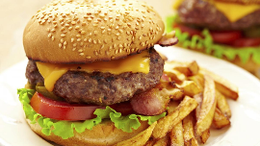
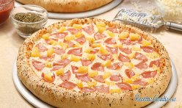
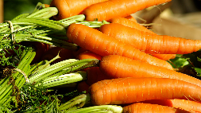
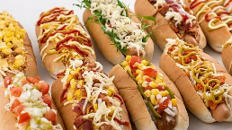
WHICH OF THESE FOODS IS HEALTHY ?
A. BURGER.
B. PIZZA.
C. CARROT.
D. HOT DOG.

Slide 3
CONGRATULATIONS IT'S CORRECT.
FOLLOWING.

Slide 4
YOU FAILED, TRY AGAIN.
FOLLOWING

Slide 5
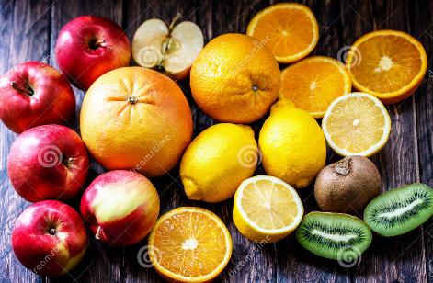
WHICH OF THESE FRUITS IS NOT ACID ?
A. LEMON
B. KIWI.
C. RED APPLE.
D. ORANGE.

Slide 6
YOU FAILED, TRY AGAIN.
FOLLOWING

Slide 7
CONGRATULATIONS IT'S CORRECT.
FOLLOWING.

Slide 8
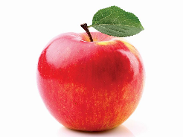
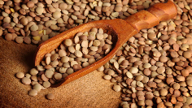
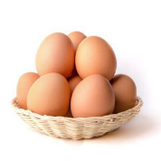
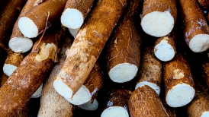
WHICH THESE MEALS IS A CARBOHYDRATE ?
APPLE
YUCCA
EGG
LENTILS

Slide 9
CONGRATULATIONS IT'S CORRECT.
FOLLOWING.

Slide 10
YOU FAILED, TRY AGAIN.
.
FOLLOWING

Slide 11
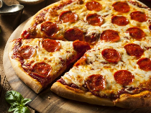
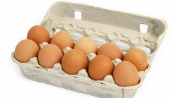
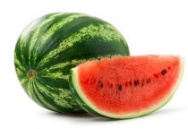
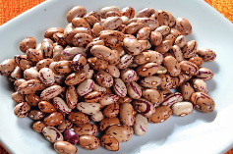
WHICH OF THESE FOODS IS HARMFUL. ?
WATERMELON
PIZZA
EGG
BEANS

Slide 12
CONGRATULATIONS IT'S CORRECT.
FOLLOWING.

Slide 13
YOU FAILED, TRY AGAIN.
FOLLOWING

Slide 14
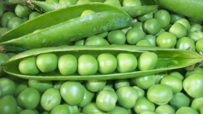
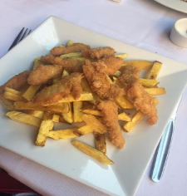
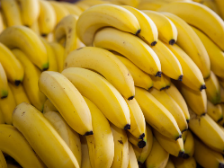
WHICH OF THESE IS NOT A VEGETABLE ?
CHICKPEAS
BANANA
PORK RIND
CHIPS

Slide 15
CONGRATULATIONS IT'S CORRECT.
FOLLOWING.

Slide 16
YOU FAILED, TRY AGAIN.
.
FOLLOWING

Slide 17
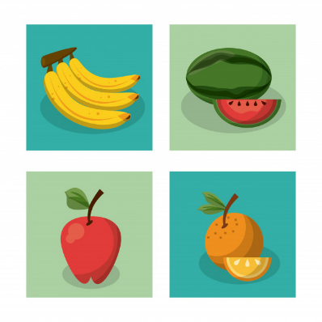
WHICH OF THESE FRUITS HAS POTASSIUM ?
ORANGE
APPLE
BANANA
WATERMELON

Slide 18
CONGRATULATIONS IT'S CORRECT.
FOLLOWING.

Slide 19
YOU FAILED, TRY AGAIN.
FOLLOWING

Slide 20
VUELVE A INTERTARLO
FINISH

Slide 21
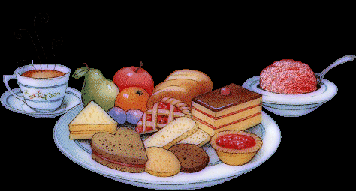
I HOPE YOU HAVE FUN. THANKS FOR YOUR ATTENTION

