Slide 1
QUESTIONS ABOUT THE HUMAN BEING
ESTUDIANTE:MARIAJOSE VALENCIA
DOCENTE :ASTRID SANCHEZ
GRADO:7-1
ASIGNATURA :INFORMATICA

Slide 2
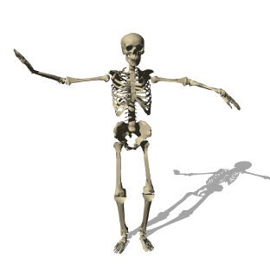
HOW MANY BONES DOES AN ADULT HAVE
A
206
B
395
C
100

Slide 3
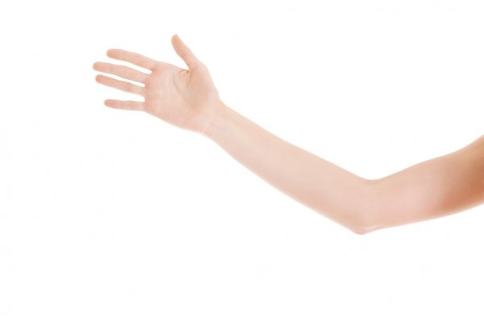
¿ What is this ?
A
ARM
B
FOOT
C
HAIR

Slide 4
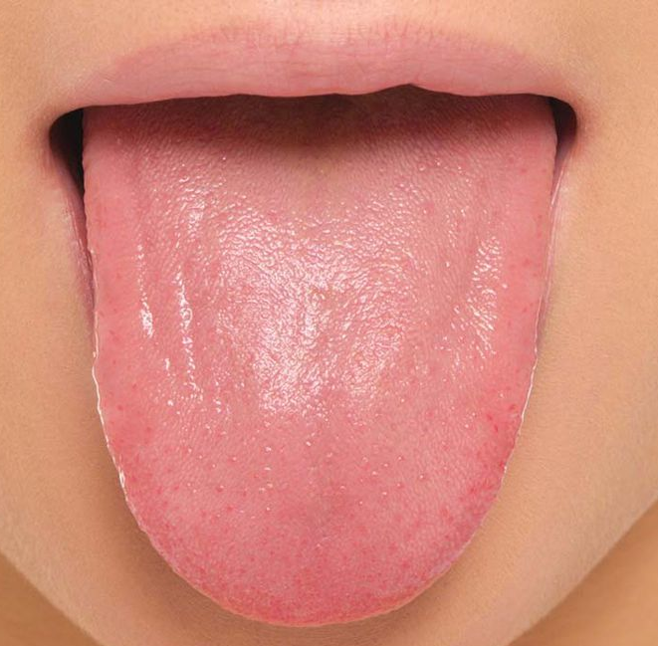
WHAT IS THIS
A
TONGUE
B
JAWBONE
C
LEG

Slide 5
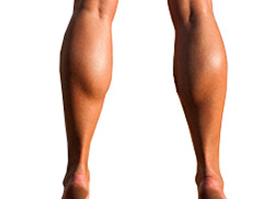
¿ What is this ?
A
calf
B
knee
C
hand

Slide 6
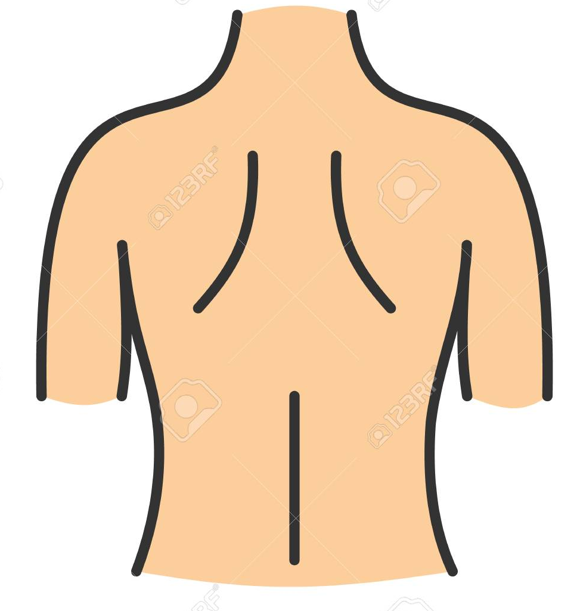
¿ What is this ?
A
HEAD
B
WAIST
C
back

Slide 7
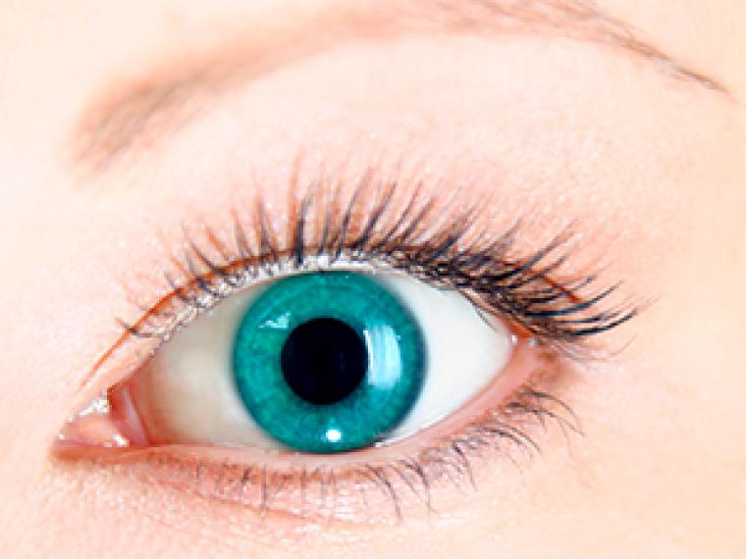
¿ What is this ?
A
eyes
B
nose
C
face

Slide 8
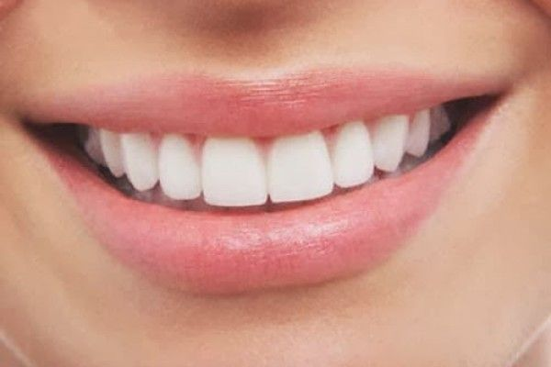
¿ What is this ?
A
EYEBROW
B
CHIN
C
MOUTH

Slide 9
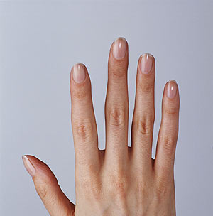
¿ What is this ?
A
FINGER
B
HEEL
C
ANKLE

Slide 10
¿ What is this ?
A
HEART
B
STOMACH
C
BONES

Slide 11
which is the hardest part of the body
WHITCH IS THE HARDEST PART OF THE BODY
A
theet
B
head
C
bones

Slide 12
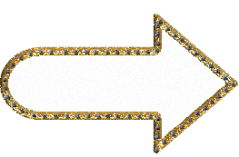
¡TRY ANOTHER QUESTION!

Slide 13
¡TRY ANOTHER QUESTION!

Slide 14
¡¡ VERY VERY GOOD KEEP IT UP !!

Slide 15
¡¡ VERY VERY GOOD KEEP IT UP !!

