Slide 1
IE.ALBERTO CARVAJAL BORRERO
NAME: ALAN BANGUERO
DATE: 11/09/2020
TEACHER:MARLIN SANCHEZ
SUBJECT: INGLES
SCHOOL: ALBERTO CARVAJAL BORRERO

Slide 2
¿WHAT DOES HE WORK ON?

Slide 3
CORRECT
NEXT

Slide 4
INCORRECT
TRY AGAIN

Slide 5
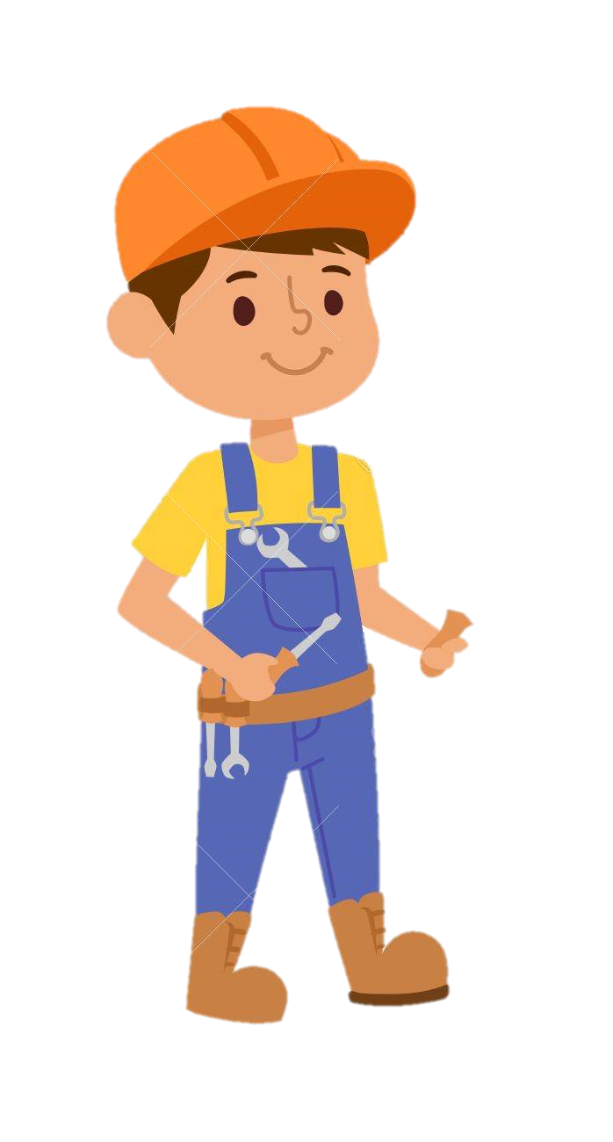
¿WHAT DOES HE WORK ON?

Slide 6
CORRECT
NEXT

Slide 7
INCORRECT
TRY AGAIN

Slide 8
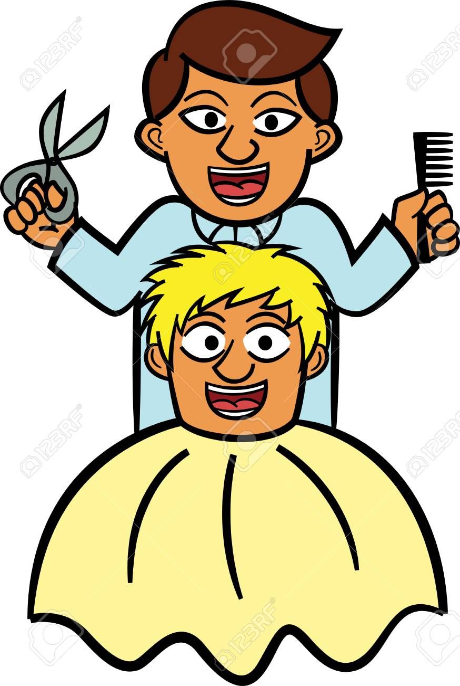
¿WHAT DOES HE WORK ON?

Slide 9
CORRECT
NEXT

Slide 10
INCORRECT
TRY AGAIN

Slide 11
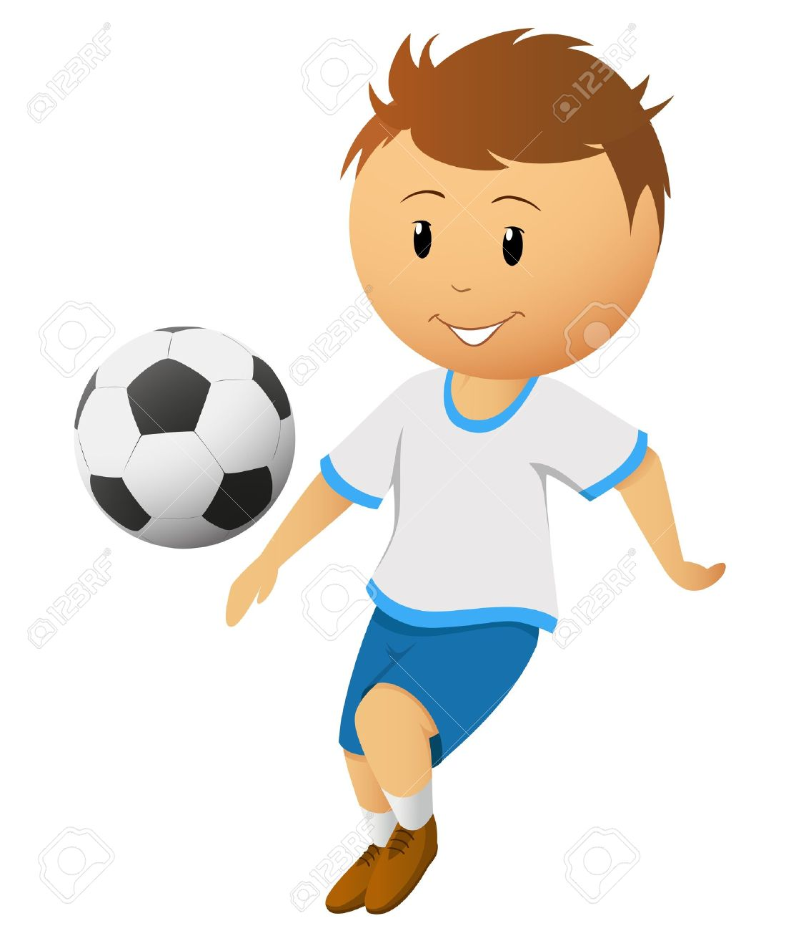
¿ DOES HE WORKWHAT ON?

Slide 12
CORRECT
NEXT

Slide 13
INCORRECT
TRY AGAIN

Slide 14
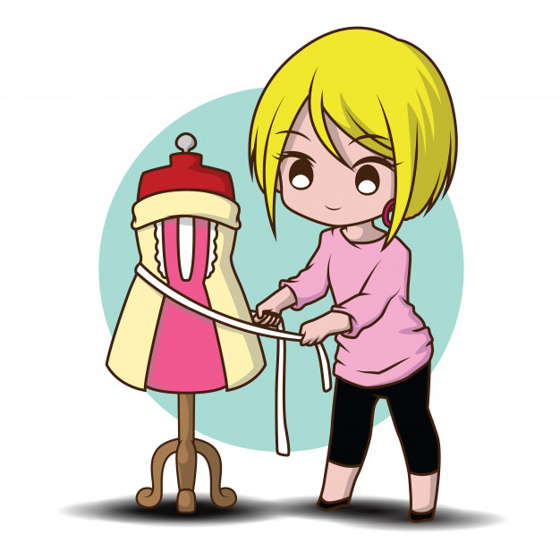
¿WHAT DOES HE WORK ON?

Slide 15
CORRECT
NEXT

Slide 16
INCORRECT
TRY AGAIN

Slide 17
¿WHAT DOES HE WORK ON?

Slide 18
CORRECT
NEXT

Slide 19
INCORRECT
TRY AGAIN

Slide 20
¿ DOES HE WORKWHAT ON?

Slide 21
CORRECT
NEXT

Slide 22
INCORRECT
TRY AGAIN

Slide 23
¿ DOES HE WORKWHAT ON?

Slide 24
CORRECT
NEXT

Slide 25
INCORRECT
TRY AGAIN

Slide 26
¿ DOES HE WORKWHAT ON?

Slide 27
CORRECT
NEXT

Slide 28
INCORRECT
TRY AGAIN

Slide 29
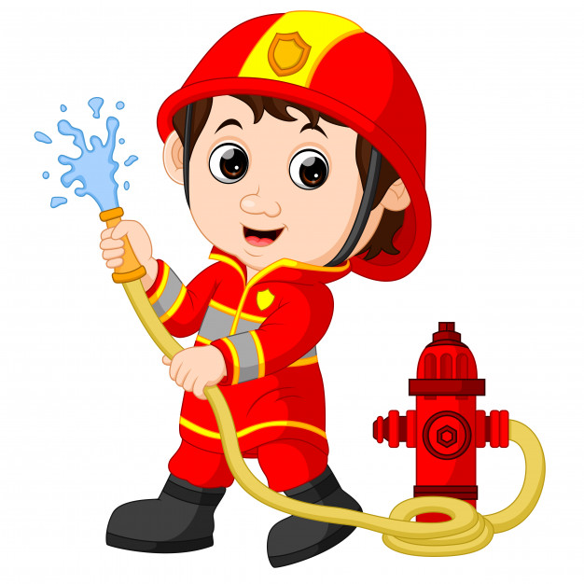
¿ DOES HE WORKWHAT ON?

Slide 30
CORRECT
NEXT

Slide 31
INCORRECT
TRY AGAIN

Slide 32
THANKS FOR PLAYING THIS GAME
REPLAY

